Slide 1
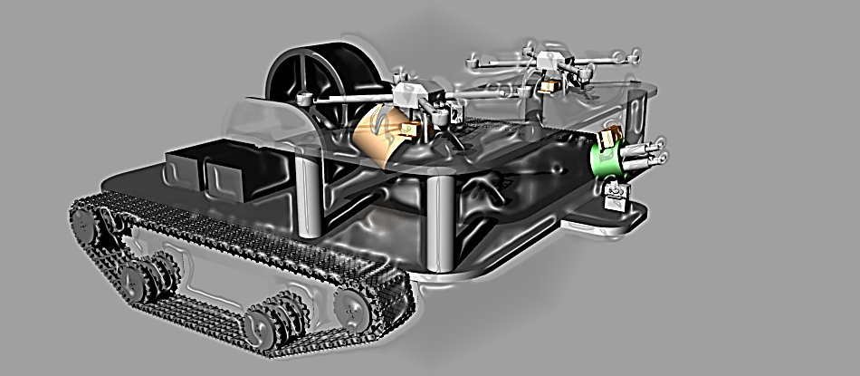
DRONENET: The Quad Chronicles
Group 07
Brandon Frazer
Raymond Lueg
Joe Howard
Ryan Borden
Sponsored By:
Notes:
Joe

Slide 2
Motivation
Design something that would be fun, have potential real-world applications, and be challenging
Utilize the two 3D printers that we personally own
Build a flying-air-vehicle (i.e. Quadcopter)
Build a ground vehicle
Wireless communication, real-time navigation, (GUI), and power sustainability
Notes:
Joe

Slide 3
Specifications and Requirements
Quadcopter
Carry a payload of less than 5 lbs.
Ability to collect data on range, altitude, and temperature
Wireless communication up to 1 mile.
Real time location that is accurate up to 1 meter
Automated landing guidance on to the mobile platform that is accurate up to a few inches.
Turret System
Quadcopter Control Terminal
Control the quadcopters through wireless communications
View real time data from the quadcopters
Pre-plan a quadcopter flight pattern (waypoints)
Communicate with the Mobile Platform Control Terminal
Notes:
Joe

Slide 4
Specifications and Requirements
Mobile Platform
Ability to charge the quadcopter
Real time location between the quadcopter and the mobile platform up to 1 meter
Automated landing guidance system to allow the quadcopter to charge itself
A turret defense system on the mobile platform to protect the quadcopter during charging
Ability to navigate through rough terrain
Ability to lock down the quadcopters while not in flight
Mobile Platform Control Terminal
Wirelessly Control the mobile platform
View all of the real time data streaming from the mobile platform
Communicate with the Quadcopter control terminal
Utilize both hardware and software based control systems
Have a touchscreen LCD display for control and monitoring
Secure User authentication
Notes:
Ray

Slide 5
Milestones for Senior Design I
September
October
November
December
Definition – 11.1.2013
Prototype → Spring
Define the parameters on which the team will be focusing - all
PCB layout
Initial project document
Research/Design – 11.15.2013
Order PCBs and parts
Research
Landing system (optical, laser, proximity) - Brandon
Power systems (efficiency, charging) - Ray
Geo-positioning system (GPS, proximity) - Joe
Wireless communication (Bluetooth, WiFi, other) - Ryan
Design
Quadrotor (power, sensors) - Ray
Mobile Platform (drive & charging systems) - Brandon
Control Terminal (GUI, communication protocol) - Joe
Documentation I – 12.7.2013
Continuous documentation of efforts - all
Assimilating all data into a final document - Ryan
Notes:
Ray

Slide 6
Milestones for Senior Design II
January
February
March
April
Prototype – 3.14.2014
Build initial prototypes
Build final prototypes
Testing – 4.4.2014
Finalize test plan
Perform testing of initial prototypes
Perform testing of final prototypes
Documentation II - TBD
Record data of test runs (video, computer)
Assimilate all documents into final draft
Notes:
Ray

Slide 7
Control
Terminal
Block
Mobile Platform
(test)
Block Diagram
Quad Telemetry
(test)
Mobile
Platform
Block
Charging System
(build/design/test)
Wireless Communication
(building/testing)
Sensors
(build/test)
Track Drive
(build/test)
Geo Positioning
(test)
Quadrotor
Block
Power Management (design/test)
Flight Controller
(test)
Raymond Lueg
Ryan Borden
Landing System
(build/test)
Geo Positioning
(test)
Brandon Frazer
Joe Howard
Notes:
ray

Slide 8
Control
Terminal
Block
Mobile Platform
(test)
Block Diagram
Quad Telemetry
(test)
Mobile
Platform
Block
Charging System
(build/design/test)
Wireless Communication
(building/testing)
Wireless Communication
(building/testing)
Sensors
(build/test)
Track Drive
(build/test)
Geo Positioning
(test)
Quadrotor
Block
Power Management (design/test)
Flight Controller
(test)
Raymond Lueg
Ryan Borden
Landing System
(build/test)
Geo Positioning
(test)
Brandon Frazer
Joe Howard
Notes:
Ray

Slide 9
Control
Terminal
Block
Mobile Platform
(test)
Block Diagram
Quad Telemetry
(test)
Mobile
Platform
Block
Charging System
(build/design/test)
Wireless Communication
(building/testing)
Wireless Communication
(building/testing)
Wireless Communication
(building/testing)
Sensors
(build/test)
Track Drive
(build/test)
Geo Positioning
(test)
Quadrotor
Block
Power Management (design/test)
Flight Controller
(test)
Raymond Lueg
Ryan Borden
Landing System
(build/test)
Geo Positioning
(test)
Brandon Frazer
Joe Howard
Notes:
Ray

Slide 10
Control
Terminal
Block
Mobile Platform
(test)
Block Diagram
Quad Telemetry
(test)
Mobile
Platform
Block
Mobile
Platform
Block
Charging System
(build/design/test)
Charging System
(build/design/test)
Wireless Communication
(building/testing)
Sensors
(build/test)
Sensors
(build/test)
Track Drive
(build/test)
Track Drive
(build/test)
Geo Positioning
(test)
Geo Positioning
(test)
Quadrotor
Block
Power Management (design/test)
Flight Controller
(test)
Raymond Lueg
Ryan Borden
Landing System
(build/test)
Geo Positioning
(test)
Brandon Frazer
Joe Howard
Notes:
Ray

Slide 11
Control
Terminal
Block
Mobile Platform
(test)
Block Diagram
Quad Telemetry
(test)
Mobile
Platform
Block
Charging System
(build/design/test)
Wireless Communication
(building/testing)
Sensors
(build/test)
Track Drive
(build/test)
Geo Positioning
(test)
Quadrotor
Block
Power Management (design/test)
Sensors
(build/test)
Raymond Lueg
Ryan Borden
Landing System
(build/test)
Geo Positioning
(test)
Brandon Frazer
Joe Howard
Notes:
Ray

Slide 12
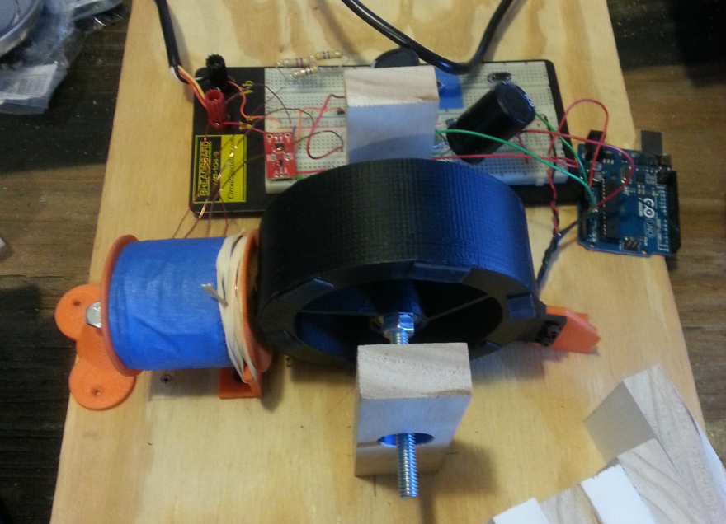
Bedini Motor
Regenerative power supply
Referenced design
Added sensing and switching circuitry
Mounted on mobile platform

Slide 13
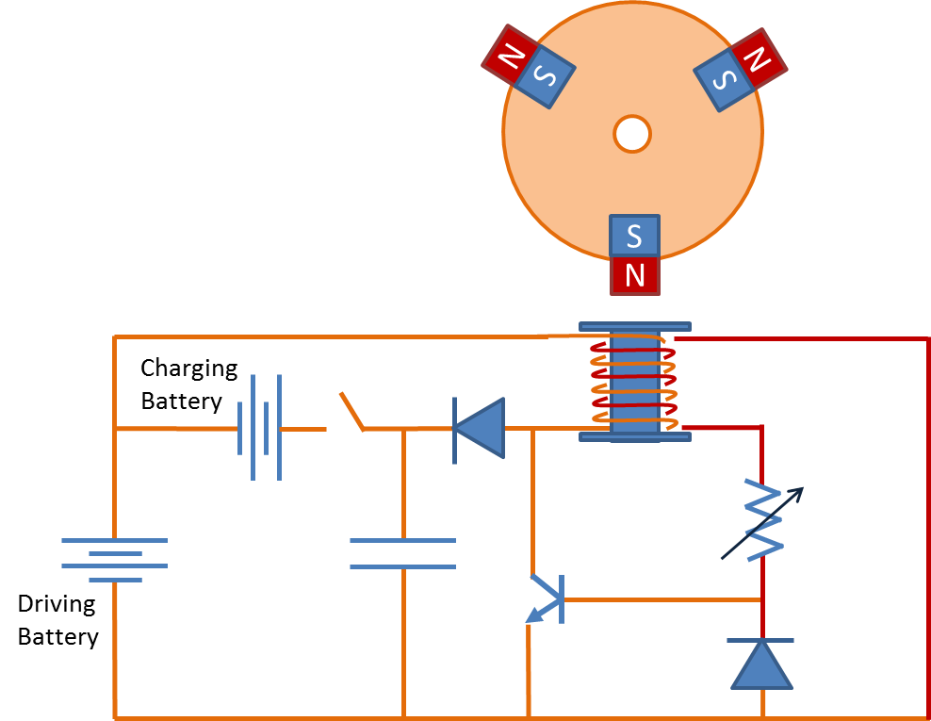
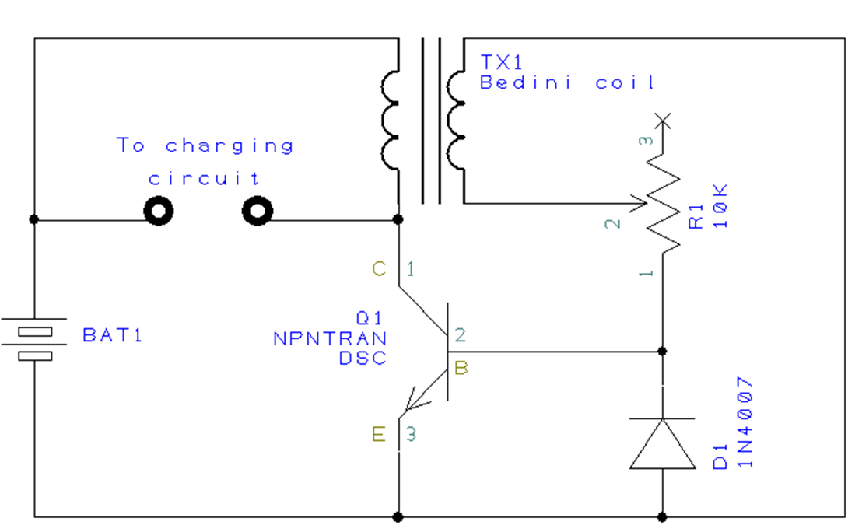
Bedini Motor
Notes:
Ray

Slide 14
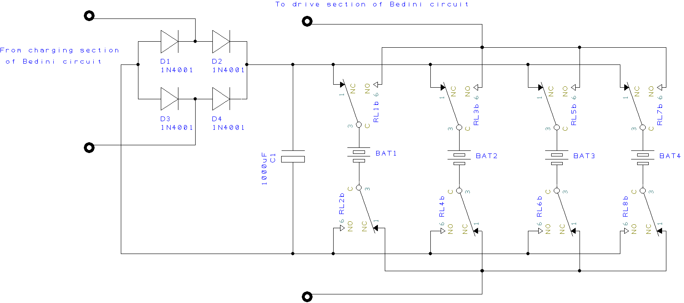
Bedini Motor
Notes:
Ray

Slide 15
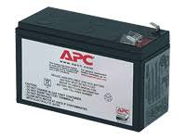
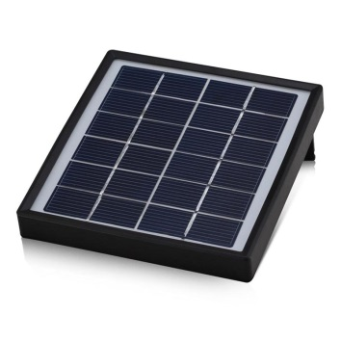
Power
Solar Panel for supplemental power
Bedini Motor with sensing circuit
Extends life of battery system
12V battery supply

Slide 16
Mobile Platform Power Distribution
Purpose
Supply 12, 5, and 3.3 volts and up to 2.5 amps from 14.4 volt battery
Design
Switching regulators vs. Linear Regulators
Efficiency
Board Space
Notes:
Ryan

Slide 17
Mobile Platform Power Distribution
Notes:
Ryan
No more GRID….snow…aka cocaine.

Slide 18
Quad Locking System
Purpose
To transport the quad copters safely while on the mobile platform.
Parameters
Easily controlled
Minimal power consumption
Stability
Notes:
Ryan

Slide 19
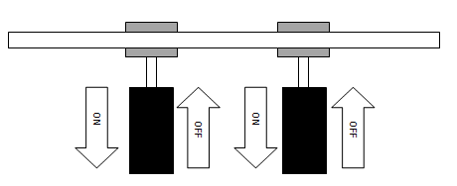
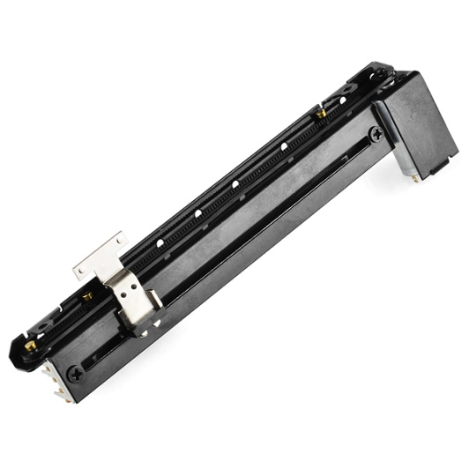
Quad Locking System
Solenoid
Slide Potentiometer
Solenoid attached to a magnet
High power consumption
14 V, 2 A
Motorized slide potentiometer
Lower power consumption
6-10 V,8 mA
Notes:
Ryan

Slide 20
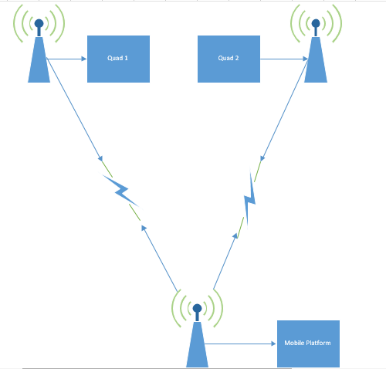
Wireless Communication
Features
Wireless programming
GPS Tracking
Altitude Tracking
Real time data collecting
Battery charge monitoring
Notes:
Ryan

Slide 21
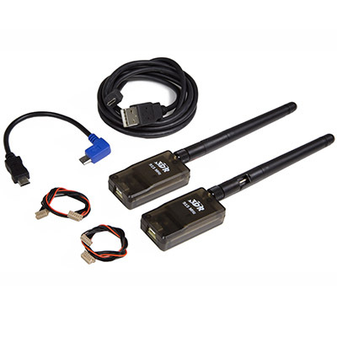
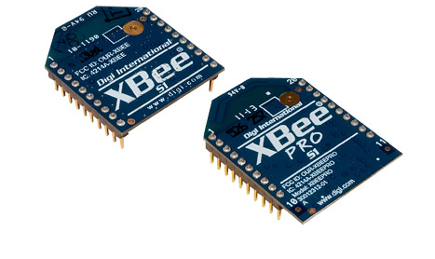
Wireless Communication
XBee Pro
3DR Telemetry
2.4 GHz
63 mW transmit power
1 mile range
$65
900 MHz
100 mW transmit power
1 mile range
$100
Notes:
Ryan
3DR TELEMTRY PIC

Slide 22
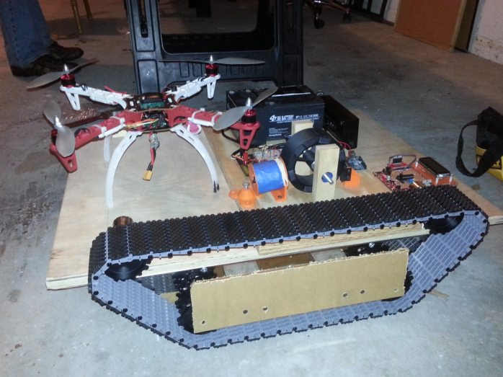
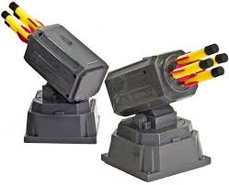
Platform
Features
4 wheel drive tank based all terrain drive system
Turret based targeting system
Renewable power system
Quadcopter locking system
Wireless communications
Active RGB Lighting
Notes:
Brandon

Slide 23
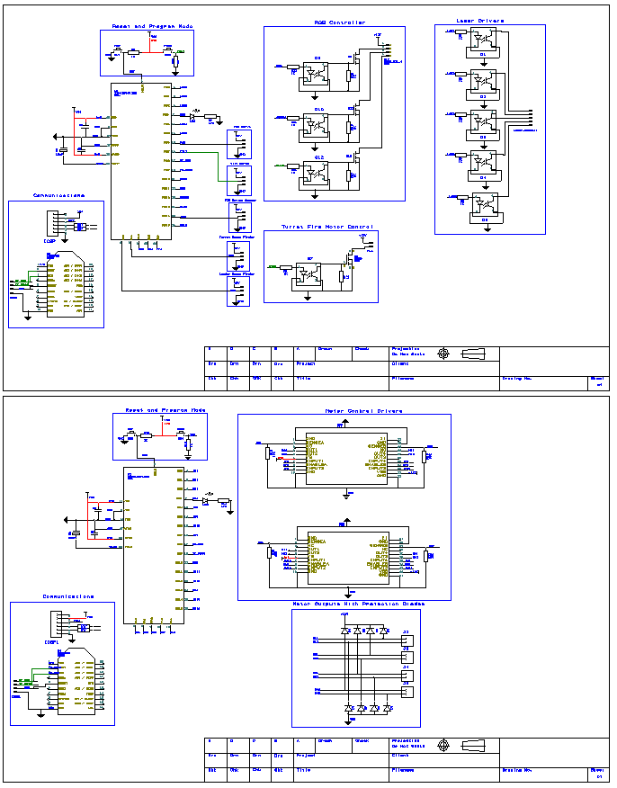
Platform Schematic
Notes:
Brandon

Slide 24
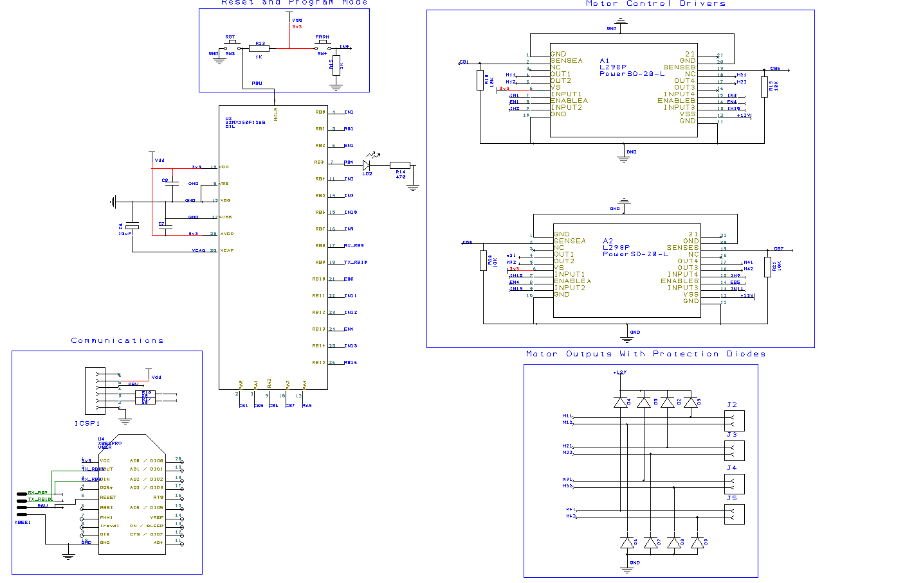
Platform 4WD Motor Control
Notes:
Brandon

Slide 25
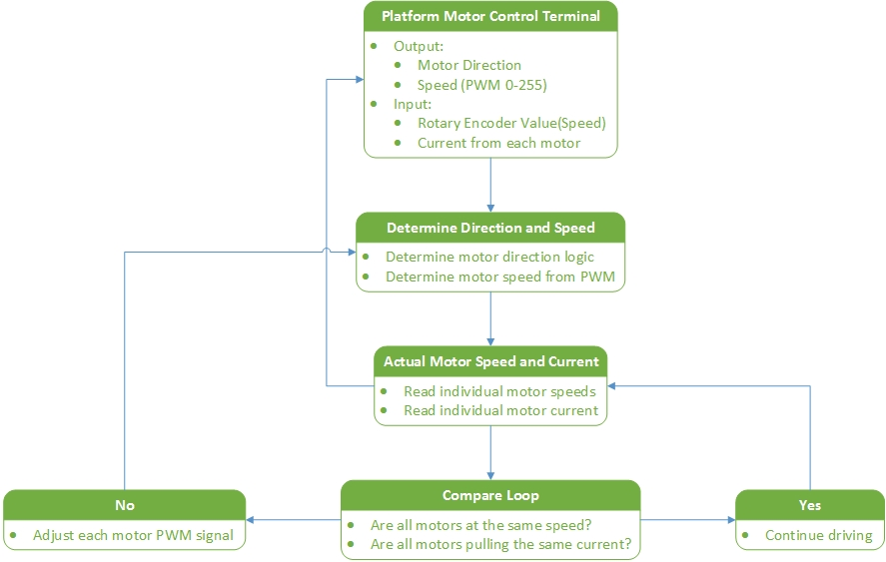
Motor Controls
Notes:
Brandon

Slide 26
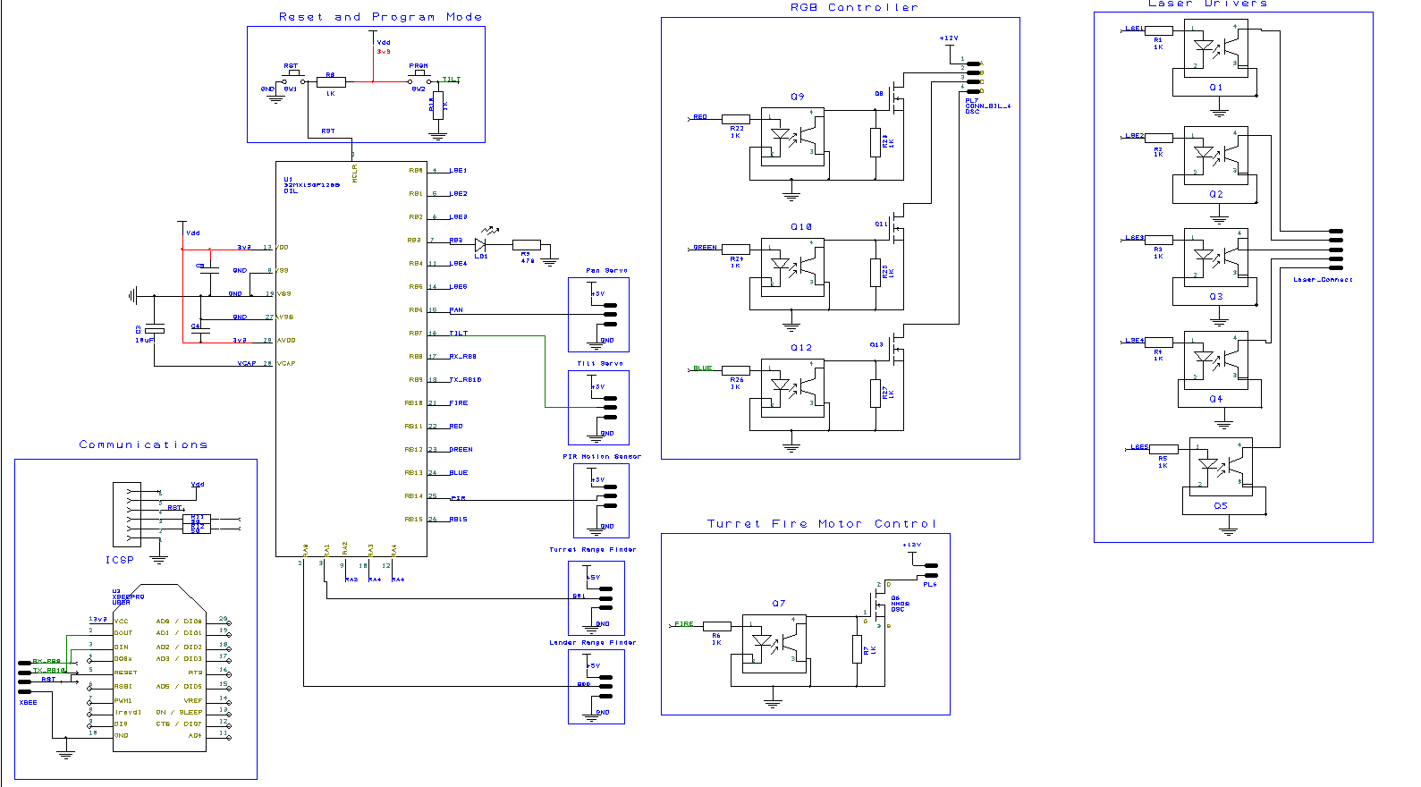
Platform Peripherals
Notes:
Brandon

Slide 27
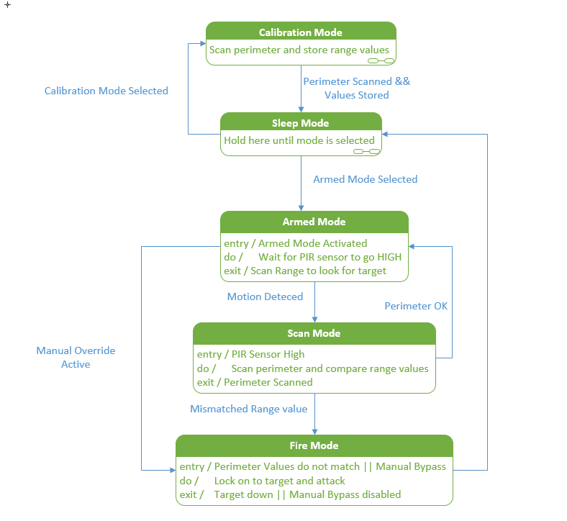
Platform Turret System
Notes:
Brandon

Slide 28
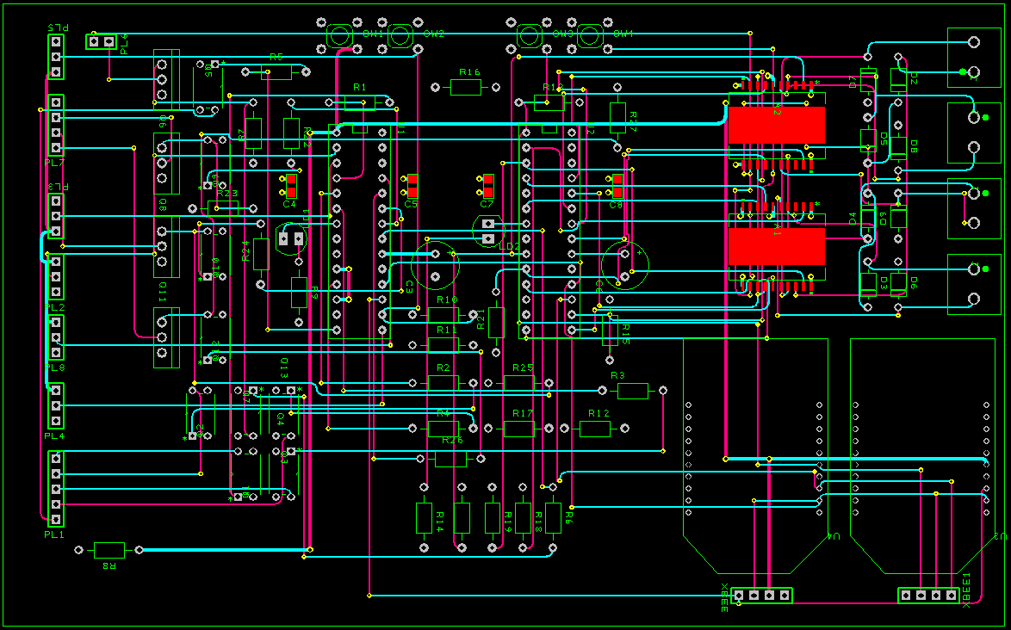
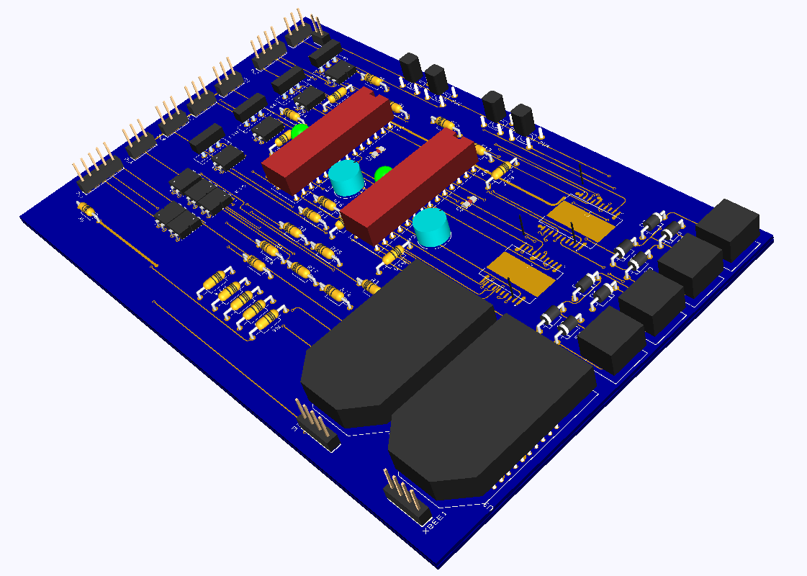
Platform PCB
Notes:
Brandon

Slide 29
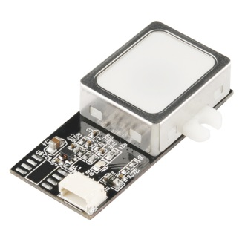
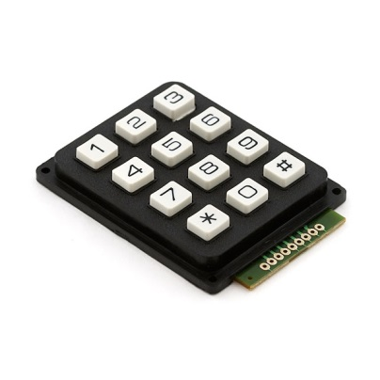
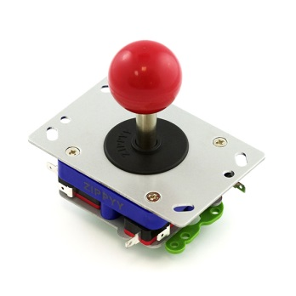
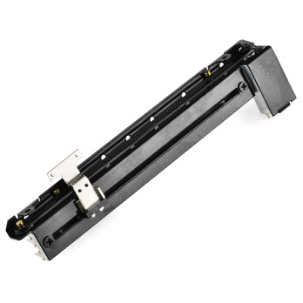
Platform Controller
Touchscreen Graphical User Interface for monitoring and control
Fingerprint scanner and PIN Keypad
Buttons/Potentiometers for motor controls, servo controls, turret controls
Notes:
Brandon

Slide 30
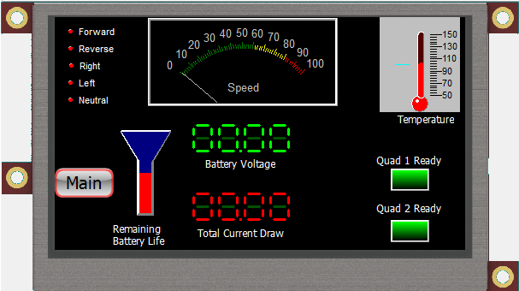
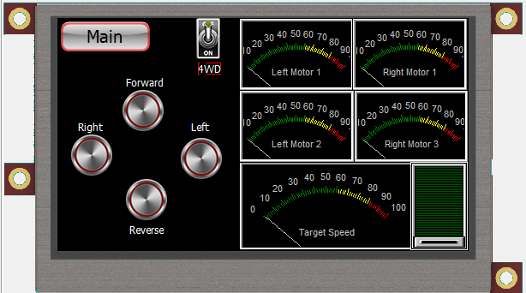
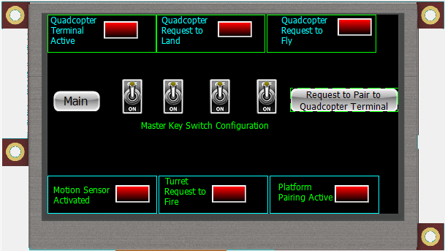
Notes:
Brandon

Slide 31
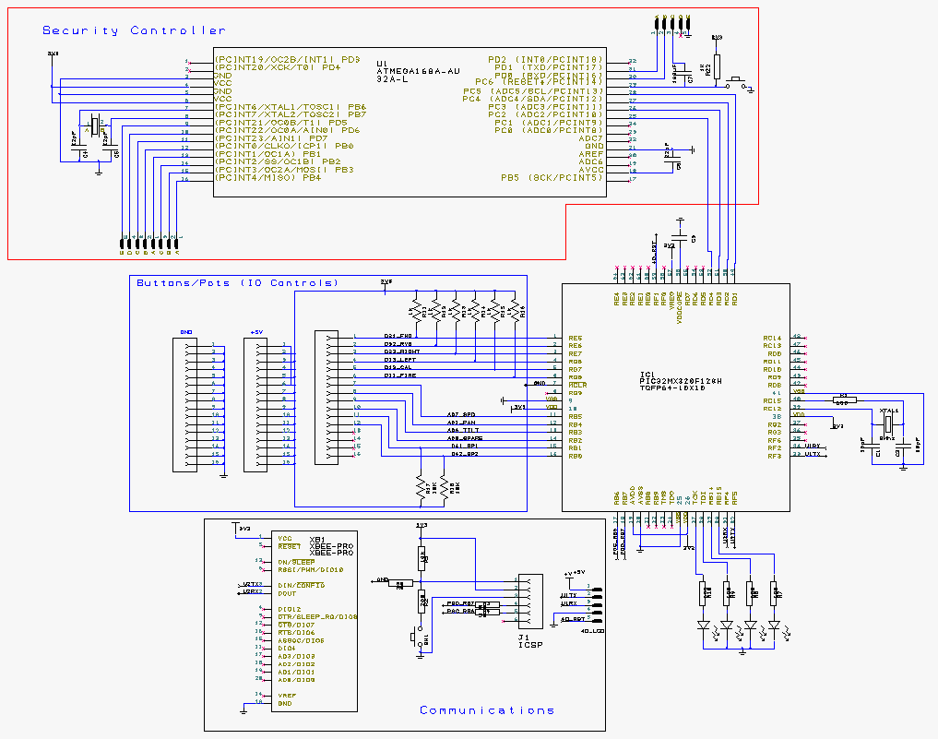
Platform Control Terminal
Notes:
Brandon

Slide 32
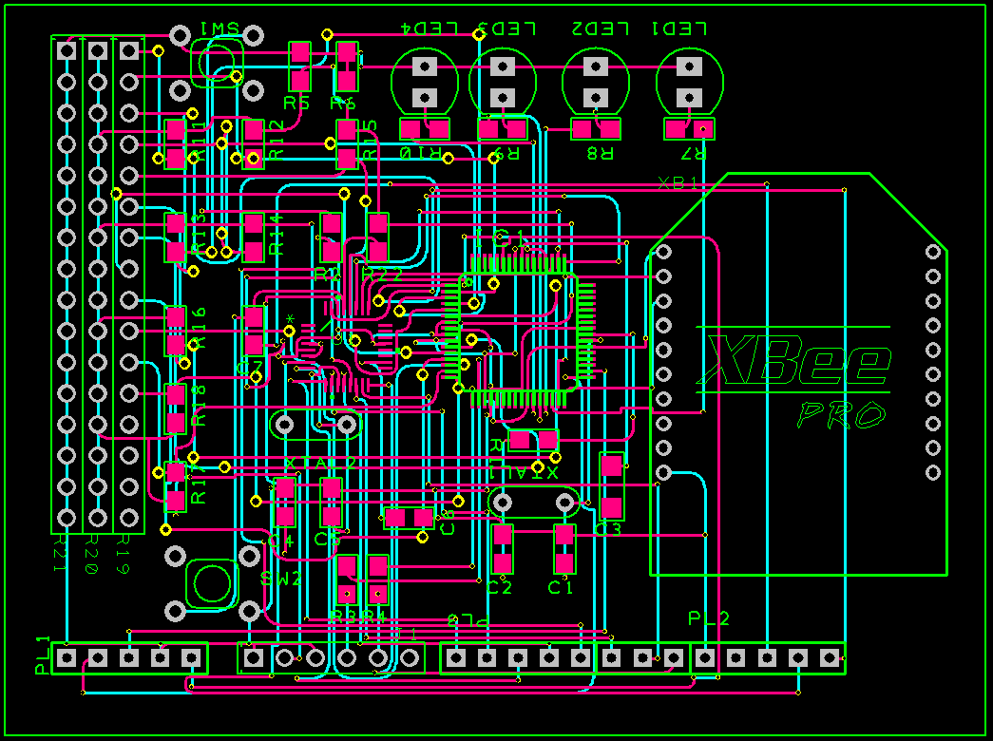
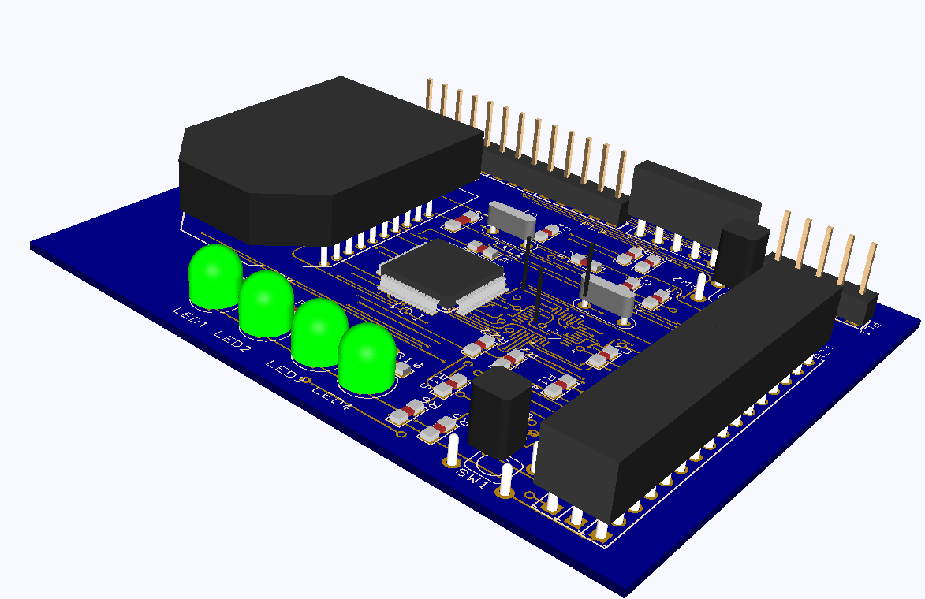
Platform Control PCB
Notes:
Brandon

Slide 33
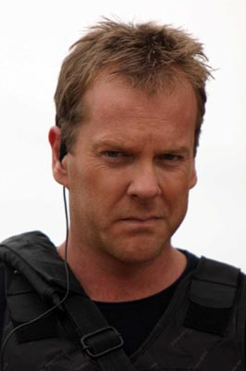
Security
Personal Identification Number (PIN) for each user
Fingerprint scanner for user authentication
Device ID using MOSFET PUF (Physically Unclonable Function)
Certain actions (such as arming the turret or unlocking/landing a quadcopter) requiring authentication codes
Notes:
Brandon

Slide 34
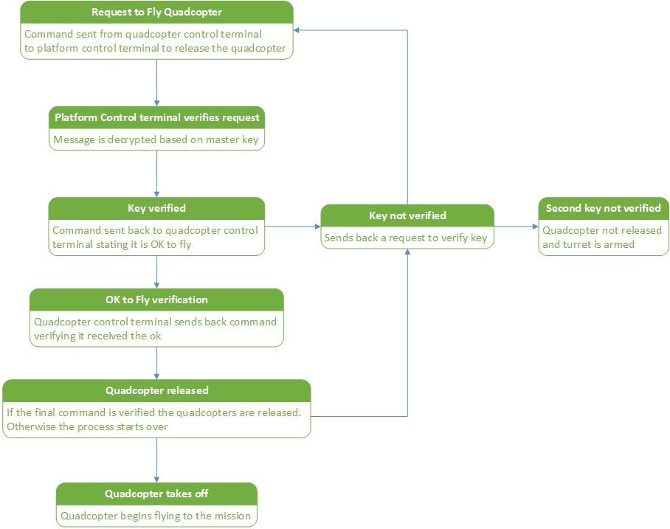
Request to Fly

Slide 35
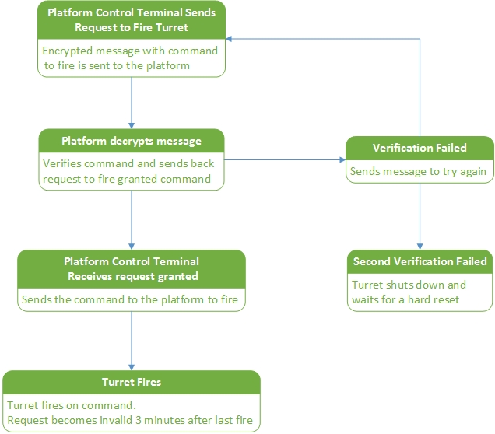
Request to Fire
Notes:
Brandon

Slide 36
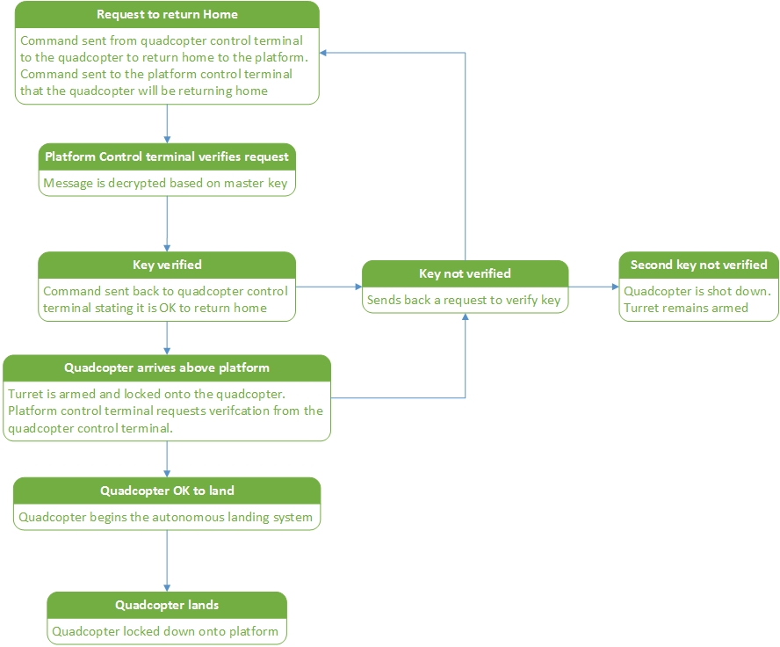
Request to Land
Notes:
Brandon

Slide 37
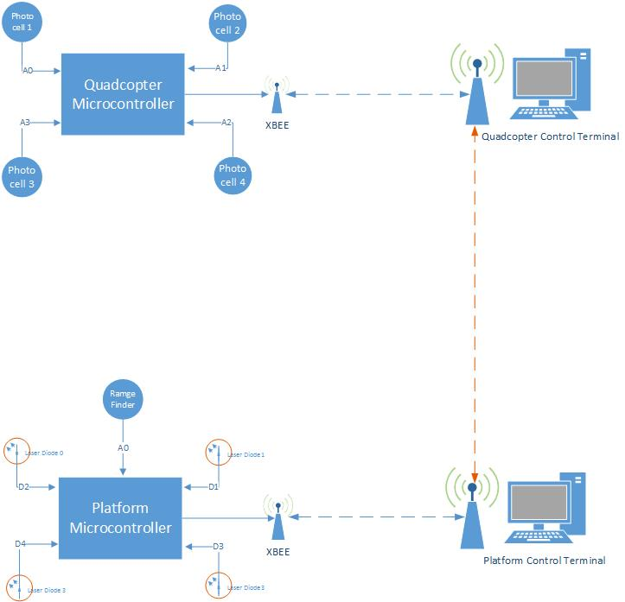
Laser Landing System
Notes:
Brandon

Slide 38
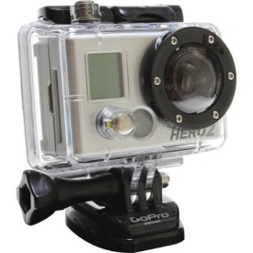
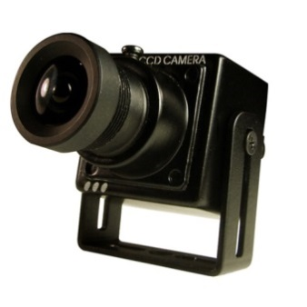
Camera System
GoPro HERO2 Camera
Medium Range First Person View (FPV)
200mW 1280mHZ transmitter/receiver with standard antenna
Onscreen Display (OSD) for the camera feedback on the ground station
Servo controlled camera for positioning
Still debating between PCB Camera (cost, power, weight, mounting)
V.S.
Notes:
Brandon

Slide 39
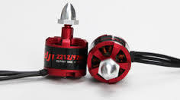
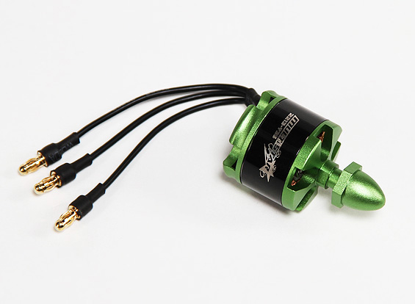
Motors
DJI 2212/920
Max Current: 30A
KV Rating: 920
Weight: 56g
Multistar 2213-935KV
Max Current: 15A
KV Rating: 935
Weight: 55g
Notes:
Joe

Slide 40
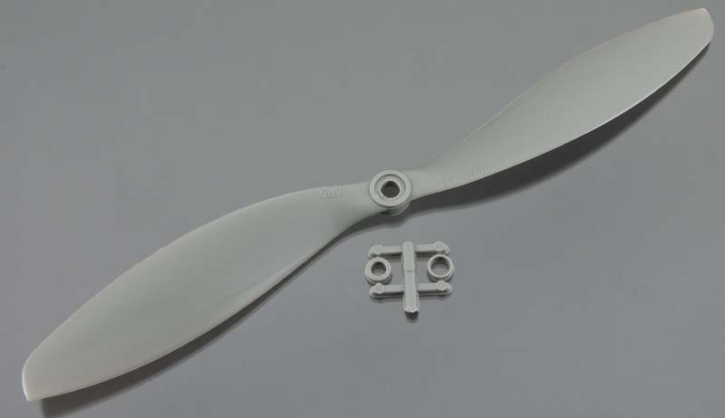
Propellers
APC 1047SF Props
10” diameter
4.7” pitch
6500 RPM limit
Estimated Max Thrust: approx. 750-800g (each)
Notes:
Joe

Slide 41
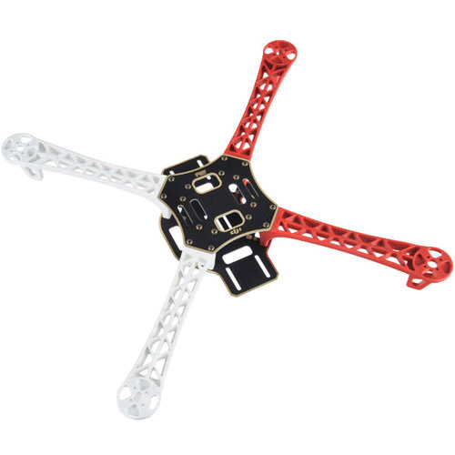
Frame
DJI Flame Wheel F450
Fiberglass
Weighs 282g
Diagonal Wheelbase 450mm
VERY STRONG
Built-in PCB for power distribution
Notes:
Joe

Slide 42
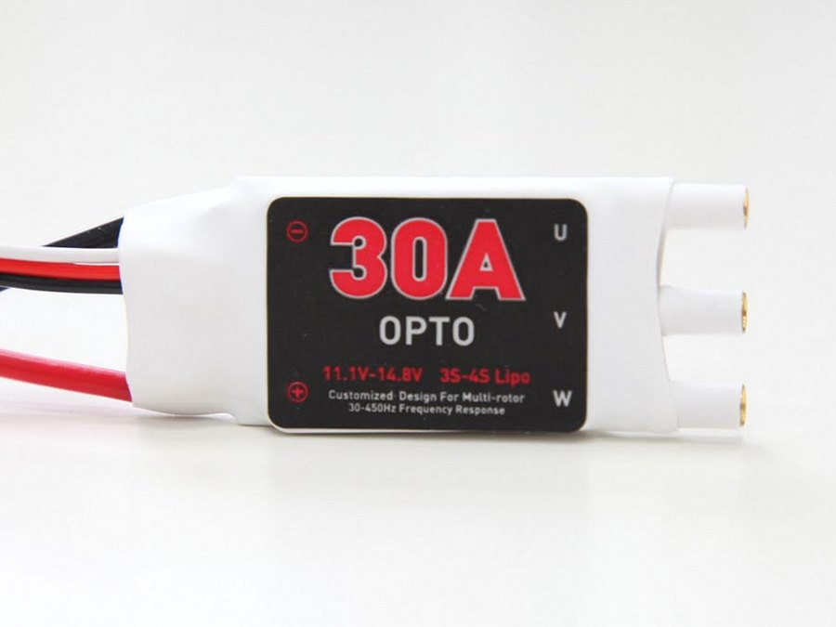
Electronic Speed Controls
ESC 30A OPTO
Max Current: 30A
OPTO-coupled for noise isolation
No calibration required
Notes:
Joe

Slide 43
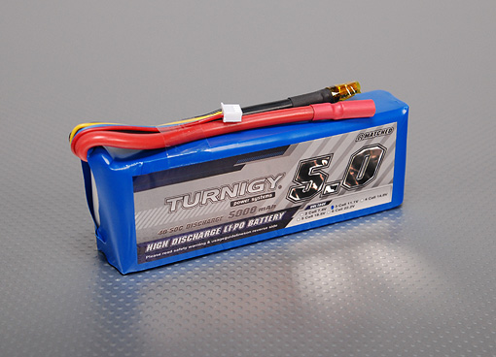
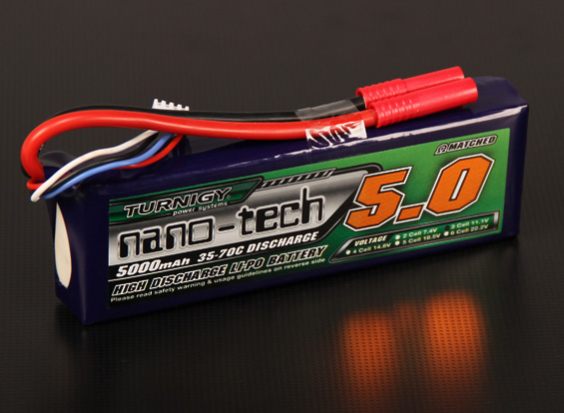
Li-Po Batteries
Turnigy 5000mAh 3S
3 Cells
Nom Voltage: 11.1V
Const. Discharge: 200A
Peak Discharge (10sec): 250A
Weight: 443g
Const. Charge Rate: 25A
Internal impedance: .003 Ω
Turnigy nano-tech 5000mAh 3S
3 Cells
Nom Voltage: 11.1V
Const. Discharge: 175A
Peak Discharge (10sec): 350A
Weight: 409g
Const. Charge Rate: 40A
Internal impedance: .0012 Ω
Notes:
Joe

Slide 44
Quad Power Flow
Notes:
Joe

Slide 45
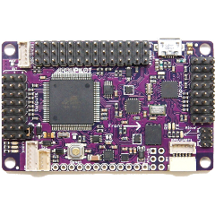
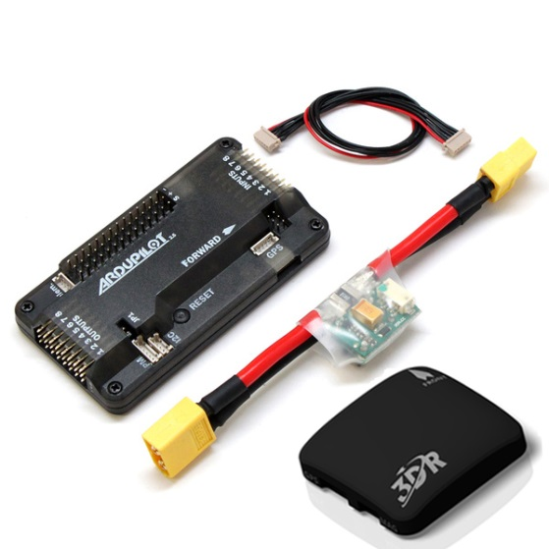
Flight Controller
For a working flight controller we need several components
Processor, accelerometer, gyroscope, on board programming, GPS, compass, and data logging
Controls motor speed
Allows for autonomous features
Notes:
Ryan

Slide 46
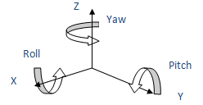
Flight Controller
Part Explanation
Gyroscope and Accelerometer
Gives us our roll and pitch orientations
Compass
Gives us our yaw orientations
Altimeter
Gives us our altitude from the ground
Notes:
Ryan

Slide 47
Flight Controller
APM 2.6 for prototyping
Able to get it for <$100 locally
Specs work for our application
Mission Planner software
Controller | Processor | Clock Speed | GPIO | UART | RAM | PWM Channels | Retail Price
APM 2.6 | Atmega 2560 | 16 MHz | 86 | 4 | 8KB | 12 | $240
Pixhawk | Cortex M4 | 168 MHz | 168 | 5 | 256 KB | 14 | $280
Notes:
Ryan

Slide 48
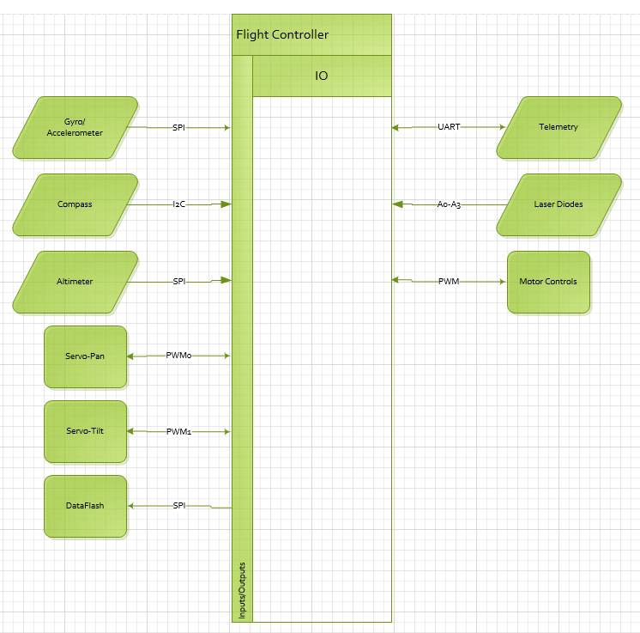
Flight Controller
Part | Part #
Processor | Atmega 2560
Gyroscope & Accelerometer | MPU 6000
Compass | HMC5883L
Altimeter | MS5611
Data logging | AT45DB161D-MU
Telemetry | XBee Pro
Notes:
Ryan
CHANGE THE DAMN GRID

Slide 49
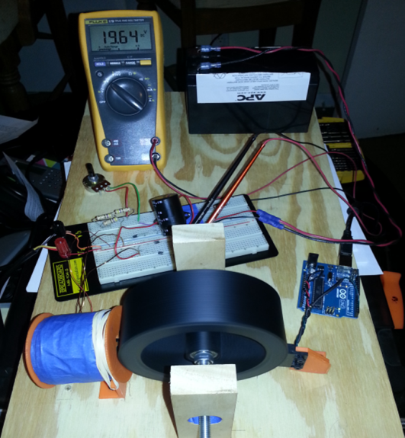
Prototypes
Notes:
?

Slide 50
Notes:
?

Slide 51
Mobile Platform Prototype
Notes:
Ryan
ADD PICS OF FLYING AND SHIIZZZZ

Slide 52
Aerial Photos: HEC

Slide 53
Aerial Photos: Light Up UCF

Slide 54
Aerial Photos: UCF From 5200 ft

Slide 55
Testing
Notes:
Ray

Slide 56
Project Progress
Notes:
Ray

Slide 57
Budget
Notes:
Brandon

Slide 58
Success
Platform Controller
Platform Motor Control
Turret System
Building/Flying the Quad
Wireless Communications
Parts acquired
Bedini Motor Prototype
Notes:
Ryan

Slide 59
Problems
Hobbyking
Props
Efficiency of the Bedini Motor
Communication systems integration
Autonomous Landing
2 quads
Notes:
Brandon

Slide 60
Questions?
Notes:
WEEEEEEEEEEEEEEEEEEEE

